Slide 1

Computer Networks
Unit - 1
Asst. Prof. Rupayali Swaroop,
Computer Science & Engineering,
JECRC University,
Jaipur.

Slide 2
Objectives
To explain need of computer networks
To introduce the fundamental types of computer networks.
To demonstrate the TCP/IP & OSI model merits & demerits.
To know the role of various protocols in Networking

Slide 3
Computer Network
A network is a set of devices (nodes) connected by communication links.
A node can be a computer, printer, or any other device capable of sending and/or receiving data generated by other nodes on the network.
Computer Network uses distributed processing in which task is divided among several computers.

Slide 4
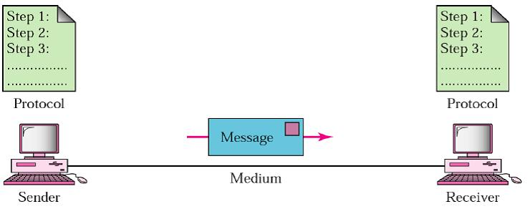
DC Component
Message
Sender
Receiver
Transmission Medium
Protocol

Slide 5
DC Component
1. Message: The message is the information (data) to be communicated. Popular forms of information include text, numbers, pictures, audio, and video.
2. Sender: The sender is the device that sends the data message. It can be a computer, workstation, telephone handset, video camera, and so on.
3. Receiver: The receiver is the device that receives the message. It can be a computer, workstation, telephone handset, television, and so on.
4. Transmission medium: The transmission medium is the physical path by which a message travels from sender to receiver. Some examples of transmission media include twisted-pair wire, coaxial cable, fiber-optic cable, and radio waves
5. Protocol: A protocol is a set of rules that govern data communications. It represents an agreement between the communicating devices. Without a protocol, two devices may be connected but not communicating, just as a person speaking French cannot be understood by a person who speaks only Japanese.

Slide 6
Topology
It defines the structure of the network of how all the components are interconnected to each other.
Two types of topology: physical and logical
Physical topology is the geometric representation of all the nodes in a network.

Slide 7
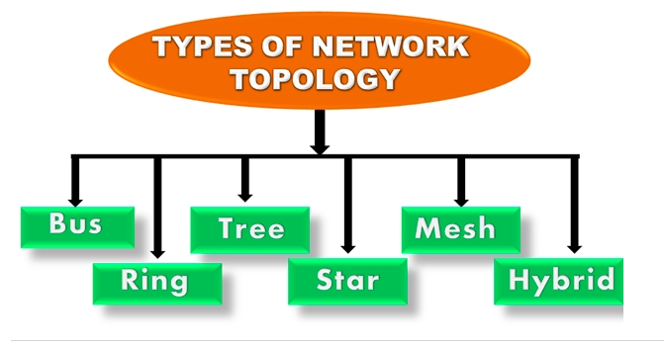

Slide 8
Bus Topology
One long cable acts as a backbone to link all the devices in a network.
Nodes are connected to the bus cable by drop lines and taps.
Drop line is a connection running between the device and the main cable.
Tap is a connector that either splices into the main cable or punctures the sheathing of a cable to create a contact with the metallic core.
Bus topology is used in 802.3 (ethernet) and 802.4 standard networks.

Slide 9
Bus Topology
One long cable acts as a backbone to link all the devices in a network.
Nodes are connected to the bus cable by drop lines and taps.
Drop line is a connection running between the device and the main cable.
Tap is a connector that either splices into the main cable or punctures the sheathing of a cable to create a contact with the metallic core.
Bus topology is used in 802.3 (ethernet) and 802.4 standard networks.

Slide 10
Bus Topology
One long cable acts as a backbone to link all the devices in a network.
Nodes are connected to the bus cable by drop lines and taps.
Drop line is a connection running between the device and the main cable.
Tap is a connector that either splices into the main cable or punctures the sheathing of a cable to create a contact with the metallic core.
Bus topology is used in 802.3 (ethernet) and 802.4 standard networks.

Slide 11
Cont...
Advantage:
Low-cost cable
Moderate data speeds
Familiar technology
Limited failure
Disadvantage:
Extensive cabling
Difficult troubleshooting
Signal interference
Reconfiguration difficult
Attenuation

Slide 12
Ring Topology
Network configuration in which device connections create a circular data path.
The data flows in one direction, i.e., it is unidirectional.
The data flows in a single loop continuously known as an endless loop.
The data in a ring topology flow in a clockwise direction.
The most common access method of the ring topology is token passing.
Token passing: It is a network access method in which token is passed from one node to another node.
Token: It is a frame that circulates around the network.

Slide 13
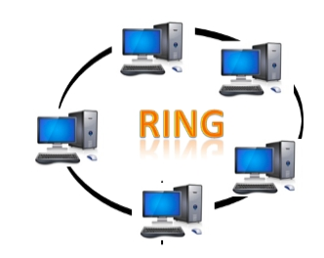
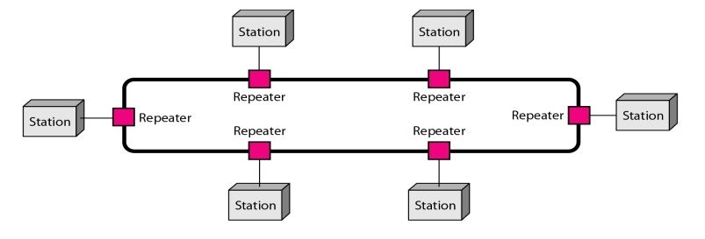
Cont...

Slide 14
Cont...

Slide 15
Working of Token passing
A token moves around the network, and it is passed from computer to computer until it reaches the destination.
The sender modifies the token by putting the address along with the data.
The data is passed from one device to another device until the destination address matches. Once the token received by the destination device, then it sends the acknowledgment to the sender.
In a ring topology, a token is used as a carrier.

Slide 16
Cont...
Advantage
Network Management
Product availability
Cost
Reliable
Disadvantage
Difficult troubleshooting
Failure
Reconfiguration difficult
Delay

Slide 17
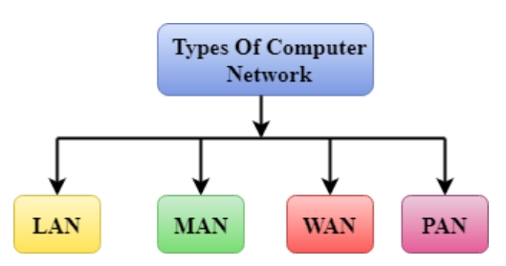
Computer Networks Type
Group of computers linked to each other that enables the computer to communicate with another computer and share their resources, data, and applications.

Slide 18
LAN (Local Area Network)
group of computers connected to each other in a small area such as building, office.
used for connecting two or more personal computers through a communication medium such as twisted pair, coaxial cable, etc.
less costly as it is built with inexpensive hardware such as hubs, network adapters, and ethernet cables.
provides higher security and Fast data Transfer

Slide 19
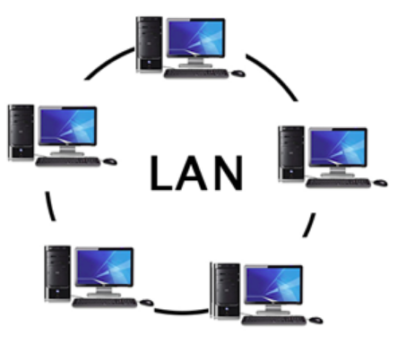
LAN

Slide 20
MAN (Metropolitan Area Network)
network that covers a larger geographic area by interconnecting a different LAN to form a larger network.
Government agencies use MAN to connect to the citizens and private industries.
In MAN, various LANs are connected to each other through a telephone exchange line.
The most widely used protocols in MAN are RS-232, Frame Relay, ATM, ISDN, OC-3, ADSL, etc.
It has a higher range than Local Area Network(LAN).

Slide 21
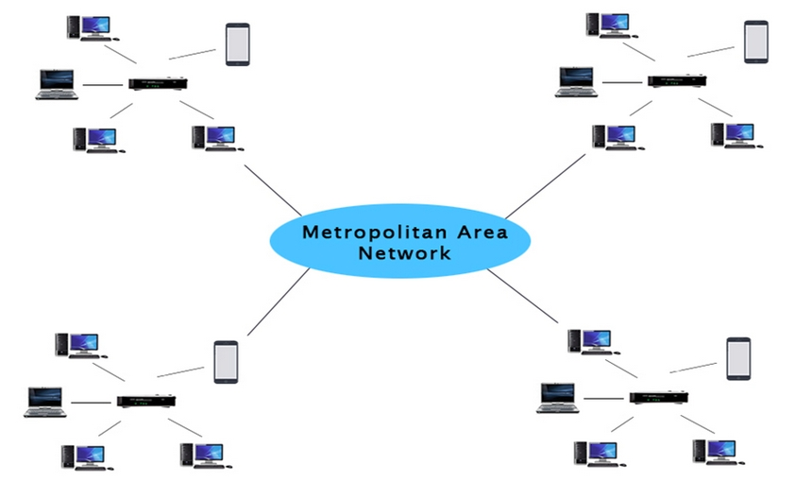
MAN

Slide 22
Use of MAN
It can be used in
Airline Reservation.
College within a city.
Communication in the military.
Communication between the banks in a city.

Slide 23
WAN(Wide Area Network)
A Wide Area Network is a network that extends over a large geographical area such as states or countries.
A Wide Area Network is quite bigger network than the LAN.
A Wide Area Network is not limited to a single location, but it spans over a large geographical area through a telephone line, fibre optic cable or satellite links.
The internet is one of the biggest WAN in the world.
A Wide Area Network is widely used in the field of Business, government, and education.

Slide 24
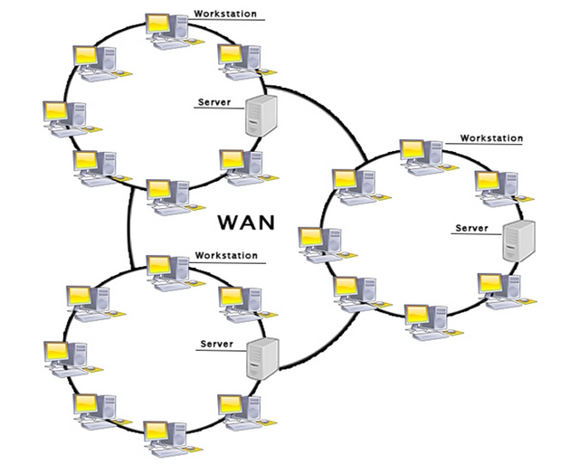
WAN

Slide 25
Examples, Advantages and Disadvantages of WAN
Examples | Advantages | Disadvantages
Mobile Broadband | Geographical area | Security issue
Last Mine | Centralized data | Needs Firewall & antivirus software
Private Network | Get updated file | High Setup cost
 | Exchange messages | Troubleshooting problems
 | Sharing of software and resources
 | Global business and High Bandwidth

Slide 26
PAN (Personal Area Network)
Personal Area Network is a network arranged within an individual person, typically within a range of 10 meters.
Personal Area Network is used for connecting the computer devices of personal use is known as Personal Area Network.
Thomas Zimmerman was the first research scientist to bring the idea of the Personal Area Network.
Personal Area Network covers an area of 30 feet.
Personal computer devices that are used to develop the personal area network are the laptop, mobile phones, media player and play stations.
Two Type of PAN
Wired Personal Area Network
Wireless Personal Area Network

Slide 27
Cont...
Wireless Personal Area Network: Wireless Personal Area Network is developed by simply using wireless technologies such as WiFi, Bluetooth. It is a low range network.
Wired Personal Area Network: Wired Personal Area Network is created by using the USB.
Examples Of PAN
Body Area Network
Offline Network
Small Home Office

Slide 28
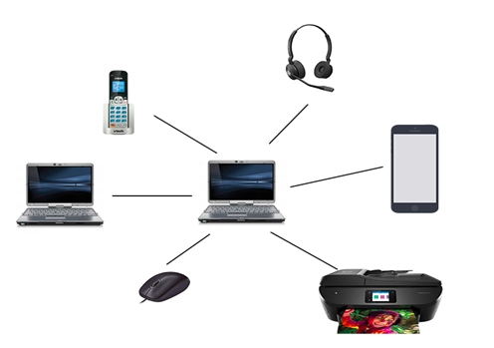
PAN

Slide 29
Internet Vs Intranet
Parameter | Internet | Intranet
Usage | Public | Private
User Typer | Any user who have dial up of internet access line | Organization employee and internal company department
Usage | Access all kind of information | Internal employee communication, telephone directories
Security | Low Security | High Security
Regulated By | IAB, IETF and IRTF, ICANN | Regulatedd by organizations
Cuverage | Wide Area | Within an Organization
Access | Large number of users | Limited number of users
System Failure | Unpredictable | System availability is high since system is monitored by authority

Slide 30
Reference Model
There are two competing models for how the software is layered. These are the OSI and the TCP models.
OSI (Open Systems Interconnection)
Developed by ISO (International Standards Organization)
7 layers
TCP/IP (Transfer Control Protocol)
Used in the Arpanet and in the Internet. Common mechanism that is surpassing the OSI Model.
5 layers

Slide 31
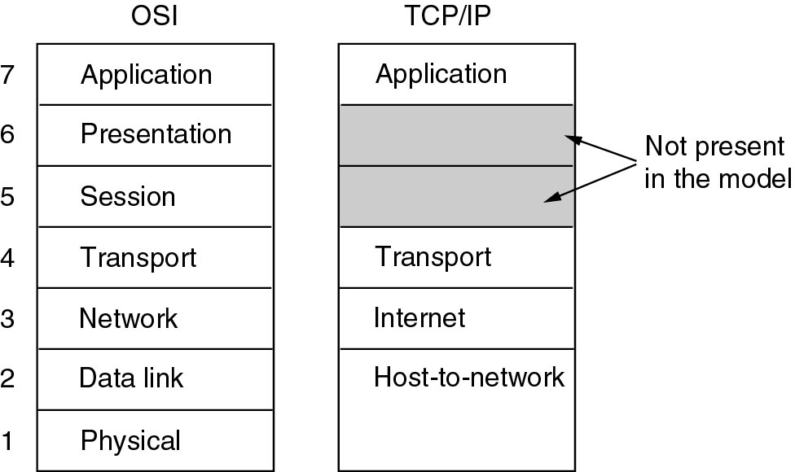

Slide 32
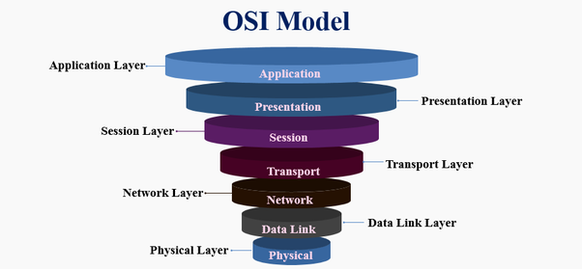

Slide 33
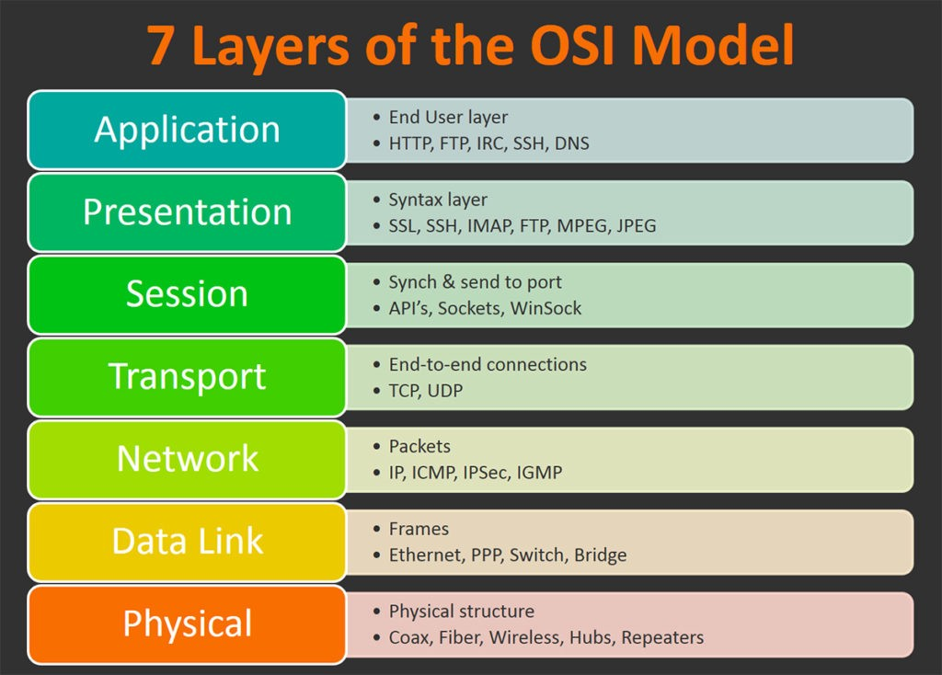

Slide 34
Cont…
◆ Physical Layer:
Purpose: Transmits raw bits across a medium.
Electrical: Concerns are voltage, timing, duplexing, connectors, etc.
❖ Data Link Layer:
Framing: Breaks apart messages into frames. Reassembles frames into messages.
Error handling: solves damaged, lost, and duplicate frames.
Flow control: keeps a fast transmitter from flooding a slow receiver.
Gaining Access: if many hosts have usage of the medium, how is access arbitrated.

Slide 35
Cont…
 Network Layer:
Routing: What path is followed by packets from source to destination. Can be based on a static table, when the connection is created, or when each packet is sent.
Congestion: Controls the number packets in the subnet.
Accounting: Counts packets/bytes for billing purposes.

Slide 36
Cont…
 Transport Layer:
Reliability: Ensures that packets arrive at their destination. Reassembles out of order messages.
Hides network: Allows details of the network to be hidden from higher level layers.
Service Decisions: What type of service to provide; error-free point to point, datagram, etc.
Mapping: Determines which messages belong to which connections.
Naming: "Send to node ZZZ" must be translated into an internal address and route.
Flow control: keeps a fast transmitter from flooding a slow receiver.

Slide 37
Cont…
 Session Layer:
Sessions: Provides services that span a particular message. For instance, a login session could be logged.
Synchronization: Provide way to subdivide a long mechanism for reliability.
 Presentation Layer:
Prettiness: Syntax and semantics of information transmitted. Understands the nature of the data being transmitted. Converts ASCII/EBCDIC, big endian/little endian
Application Layer:
Interfacing: Terminal type translation.
File transfer: Programs able to understand directory structures and naming conventions and map them onto various systems.

Slide 38
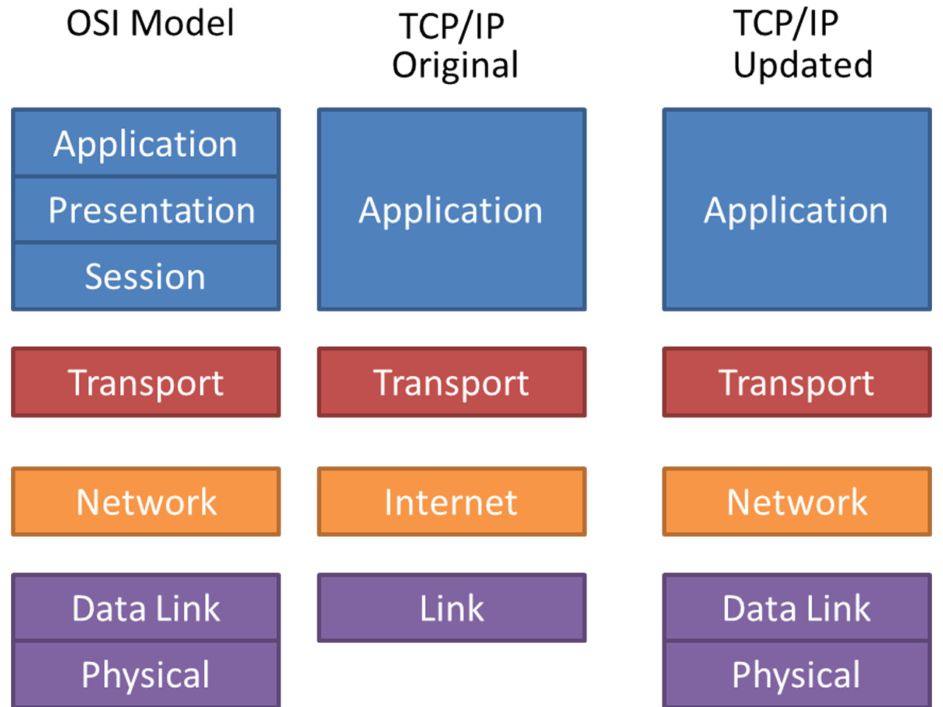
TCP/IP Reference Model

Slide 39
Cont…
◆ Physical Layer:
Purpose: Transmits raw bits across a medium.
Electrical: Concerns are voltage, timing, duplexing, connectors, etc.
❖ Data Link Layer:
Framing: Breaks apart messages into frames. Reassembles frames into messages.
Error handling: solves damaged, lost, and duplicate frames.
Flow control: keeps a fast transmitter from flooding a slow receiver.
Gaining Access: if many hosts have usage of the medium, how is access arbitrated.

Slide 40
Cont…
⬥ Internet Layer
Connector: Provides packet switched connectionless service.
Routing :The IP (Internet Protocol) does delivery and congestion control.
Transport Layer
TCP (Transmission Control Protocol): provides a reliable connection oriented protocol that delivers a byte stream from one node to another. Guarantees delivery and provides flow control.
UDP (User Datagram Protocol) provides an unreliable connection-less protocol for applications that provide their own.

Slide 41
Cont…
Application Layer
Terminal Telnet
File transfer FTP
The Web HTTP
Mail SMTP

Slide 42
Computer Network (DLL-Flow Control)
Understand flow Control
Understanding the work and problems of:
Stop-and-wait protocol
Stop-and-wait ARQ protocol
Sliding window protocol
Go-Back-N ARQ
Selective Repeat ARQ

Slide 43
Flow Control
Speed maching Mechanism
Flow control coordinates the amount of data that can be sent before receiving an ack.
Flow control is a set of procedures that tells the sender how much data it can transmit before it mucst wait for ack from receiver.
Receiver has a limitedd speed at which it can process incomming data and a limited amount of memory in which to store incoming data.
Receiver must inform the sender before the limits are reached and request that the transmitter to send fewer frames or stop temporarily.

Slide 44
Flow Control -- Protocols
Protocols
Noiseless Chanels
Noisy Chanels
1) Stop-and-wait ARQ 2) Go-Back-N-ARQ 3) Selective Repeat ARQ
1) Simplest 2) Stop-and-Wait

Slide 45
Stop-and-Wait Protocol
It provides unidirectional data transmission with flow control facilities but without error control facilities.
The idea of stop-and-wait protocol is straightforward.
After transmitting one frame, the sender waits for an ACK before transmitting the next frame.
Rules | Sender Side | Receiver Side
Rule 1 | Send one data packet at a time | Receive and consumme data packet
Rule 2 | Send the next packet only after receiving ACK for previous. | After consuming packet, ACK need to be sent

Slide 46
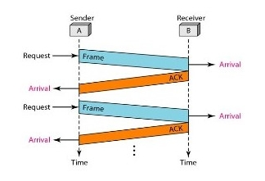
Stop-and-Wait Protocol

Slide 47
Cont...
Advantage:
Simplicity
Disadvantage:
Time consuming
- if 1000 packet then we have to wait long time for data transfer.

Slide 48
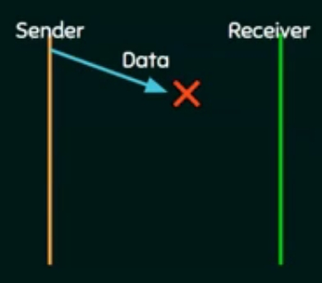
Problems: Stop-and-Wait Protocol
1: Problem due to Lost of data
Sender waits for ACK for an infinite amount of time
Receiver waits for data an infinite amount of time.

Slide 49
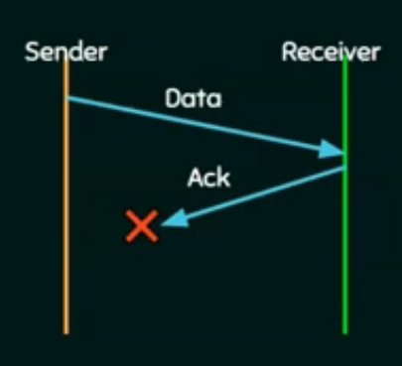
Problems: Stop-and-Wait Protocol
2: Problem due to Lost ACK
Sender waits for an infinite amount of time for ACK.

Slide 50
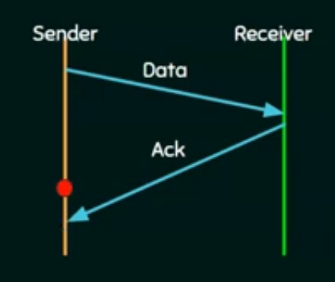
Problems: Stop-and-Wait Protocol
3: Problem due to Delayed ACK/data
After timeout on sender side, a ledayed ack might be wrongly considered as ack of some other data packet.

Slide 51
Stop-and wait ARQ Protocol
After transmitting one frame, the sender waits for an ACK before transmitting the next frame.
If the ACK does not arrive after a certain period of time, the sender times out and retransmits the original frame.
Stop-and-wait ARQ = Stop-and-wait + Timeout Timer + Sequence No.

Slide 52
Stop-and wait ARQ Protocol
After transmitting one frame, the sender waits for an ACK before transmitting the next frame.
If the ACK does not arrive after a certain period of time, the sender times out and retransmits the original frame.
Stop-and-wait ARQ = Stop-and-wait + Timeout Timer + Sequence No.

Slide 53
Stop-and wait ARQ Protocol
After transmitting one frame, the sender waits for an ACK before transmitting the next frame.
If the ACK does not arrive after a certain period of time, the sender times out and retransmits the original frame.
Stop-and-wait ARQ = Stop-and-wait + Timeout Timer + Sequence No.

Slide 54
Stop-and wait ARQ Protocol
After transmitting one frame, the sender waits for an ACK before transmitting the next frame.
If the ACK does not arrive after a certain period of time, the sender times out and retransmits the original frame.
Stop-and-wait ARQ = Stop-and-wait + Timeout Timer + Sequence No.

Slide 55
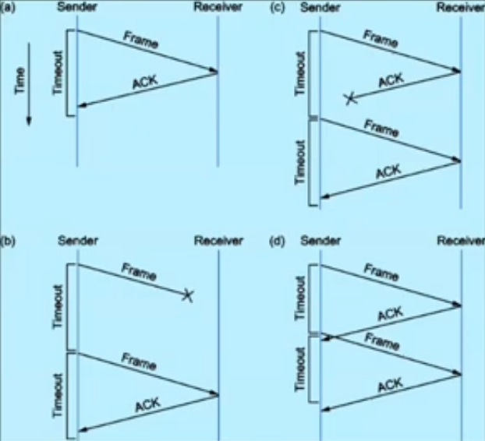
Stop-and wait ARQ Protocol
(a) The ACK is received before the timer expires.
(b) The original frame is lost
(c) The ACK is lost
(d) The timeout fires too soon.

Slide 56
Stop-and-wait ARQ Drawbacks
One frame at a time
Poor utilization of bandwidth
Poor Performance.

Slide 57
Sliding Window Protocol
The problem of “Stop-and-wait” is not able to send multiple frames. So, Sliding window is introduced for Sending multiple frames at a time.
Receiver has buffer of W (window size )
Number of frames to be sent is based on Window size without ACK.
Each frame is numbered --> Sequence No.

Slide 58
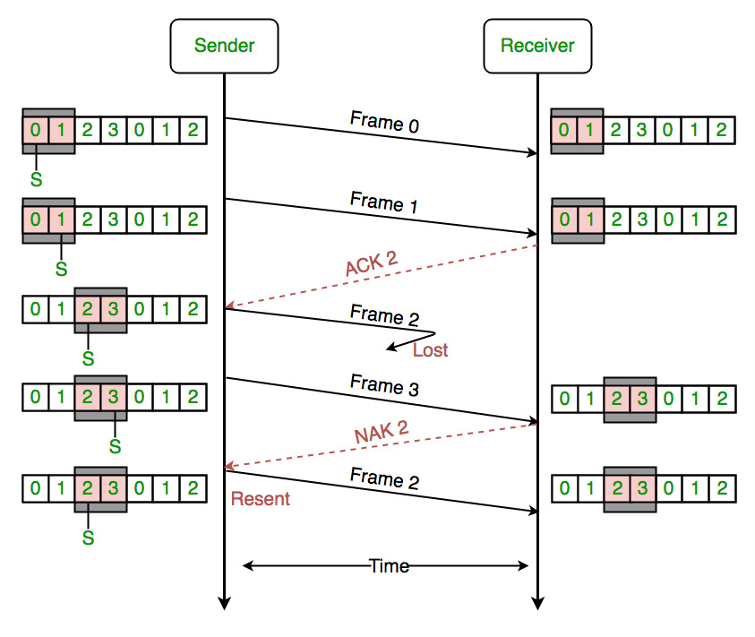
Sliding Window Protocol
0 | 1 | 2 | 3 | 0 | 1 | 2
W =
2

Slide 59
Go-Back-N ARQ
Based on sliding window.
If no error, ACK as usual with next frame expected.
Sender uses window to control the number of unacknowledged/NACK frames.
If error, reply with rejection (NACK)
Discard that frame and all future frames until the frame in error recieved correctly.
Transmitter must go back and retransmit that frame and all subsequent frames.

Slide 60
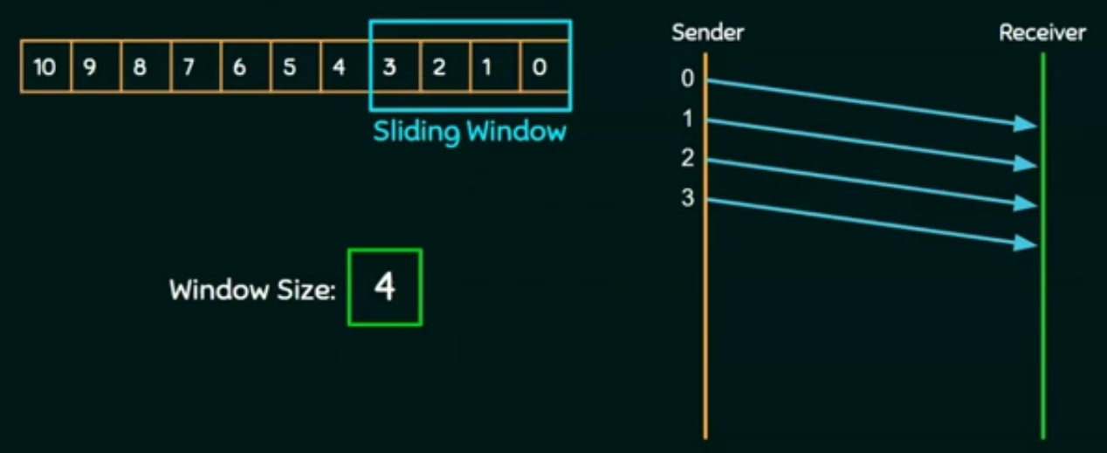
Go-Back-N ARQ

Slide 61
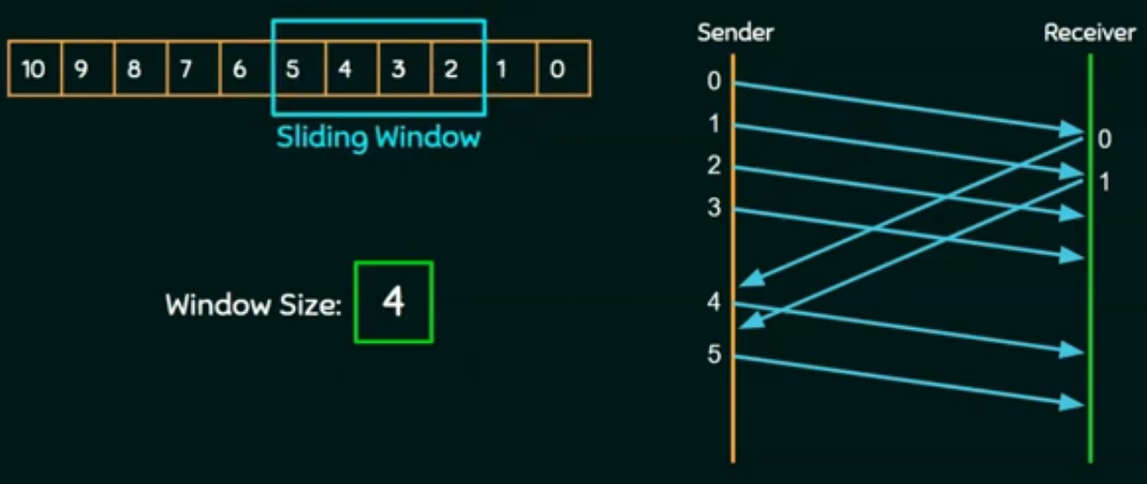
Go-Back-N ARQ

Slide 62
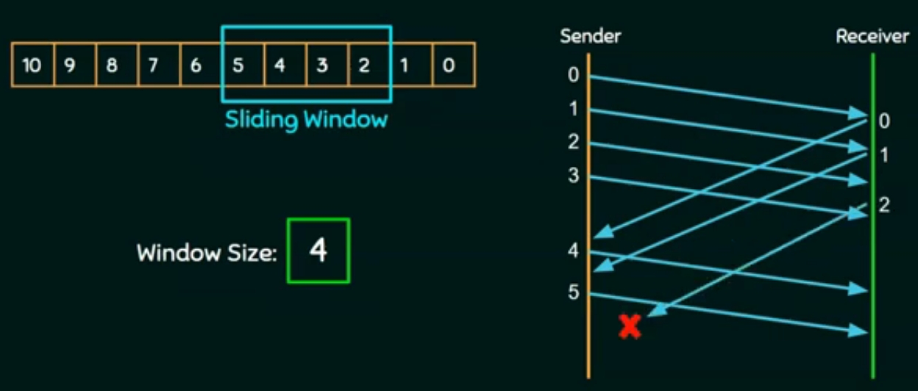
Go-Back-N ARQ
ACK not received i time, SO Sender times out

Slide 63
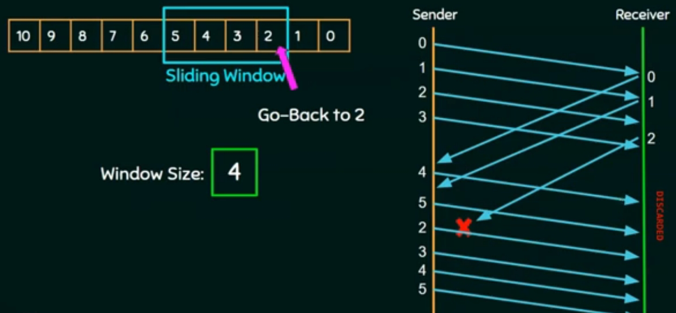
Go-Back-N ARQ

Slide 64
Go-Back N ARQ
Advanatages | Disadvantages
The sender can send many frames at a time. | Buffer Requirement
Timeer can be set for a group of frames | Transmitter needs to store the last N packets
One ACK can acknowledge more than one frames | Scheme is ineffiecient when round-trip delay large and data transmission rate is high
Efficiency is more | Retransmission of many error-free packets followinng an erroneous packet

Slide 65
Selective Repeat ARQ
In Selective Repeat ARQ , only the erroneous or lost frames are retransmittedd, while correct frames are received and buffered.
The receiver while keeping track of sequence numbers, buffers the frames in memory and sends NACK fo only frame which is missing or damaged.
The sender will send/retransmit packet for which NACK recieved.

Slide 66
Selective Repeat ARQ

Slide 67
Selective Repeat ARQ

Slide 68
Selective Repeat ARQ

Slide 69
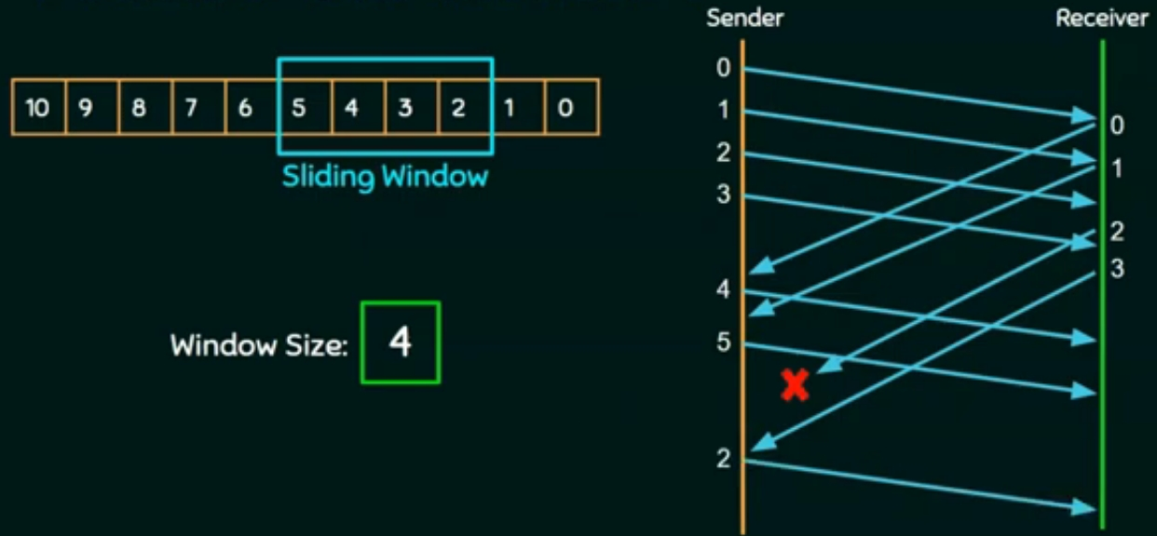
Selective Repeat ARQ

Slide 70
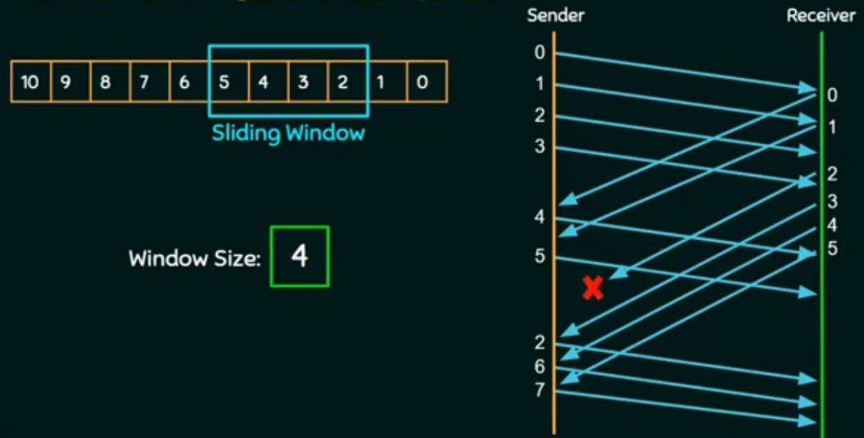
Selective Repeat ARQ

Slide 71
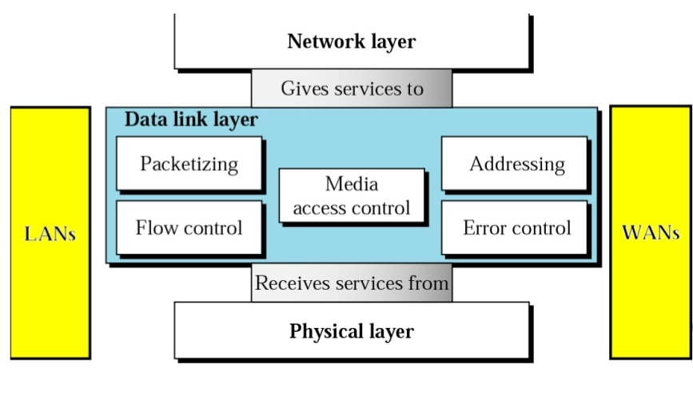
Data Link Layer
DLL transforms the physical layer, a transmission facility, to a link responsible for node-to-node communication.

Slide 72
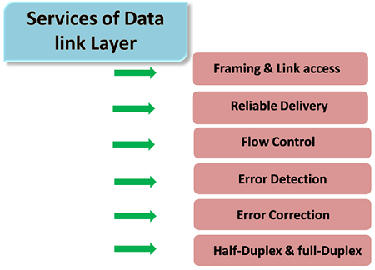
Data Link Layer
It is responsible for moving data(frames) from one node to another node.

Slide 73
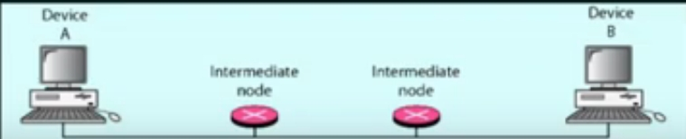
Framing
The data link layer needs to pack bits into frames, so that each frame is distinguishable from another.
e.g.- Hello, how are you?
Framing is very important task of DLL.
The simple act of inserting a Word into seprates one piece of information from another, the word serves as the delimiter

Slide 74
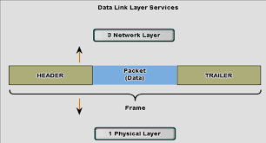
Physical Addressing
A frame is the encapsulation of the header and trailer information with the packet.
In the header, the source and the destination MAC address are dealt.

Slide 75
Flow Control
Flow control is one of the duties of data link control sublayes.
The flow control in data link layer is end to end flow control.
Speed maching mechanism.
Flow control coordinates the amount of data that can be sent before receiving an acknowledgment.

Slide 76
Error Detection And Error Control
Error A condition when the receiver’s information does not match with the sender’s information. During transmission, digital signals suffer from noise that can introduce errors in the binary bits travelling from sender to receiver. That means a 0 bit may change to 1 or a 1 bit may change to 0.

Slide 77
Error Detecting Codes :
Whenever a message is transmitted, it may get corrupted by noise. To avoid this, we use error-detecting codes which are additional data added to a given digital message to help us detect if any error has occurred during transmission of the message.
Techniques for error detection are:
Simple Parity check
Two-dimensional Parity check
Checksum
Cyclic redundancy check

Slide 78
Simple Parity check:
It is a simple mechanism and inexpensive to detect the errors.
In this method, a redundant bit is also known as a parity bit which is added at the end of the data unit so that the no. of 1’s become even.
If the no. of 1’s bit is odd then parity bit 1 is appended and if the number of 1s bits is even, then parity bit 0 is appended at the end of the data unit.
At the receiving end, the parity bit is calculated from the received data bits and compared with the received parity bit.

Slide 79
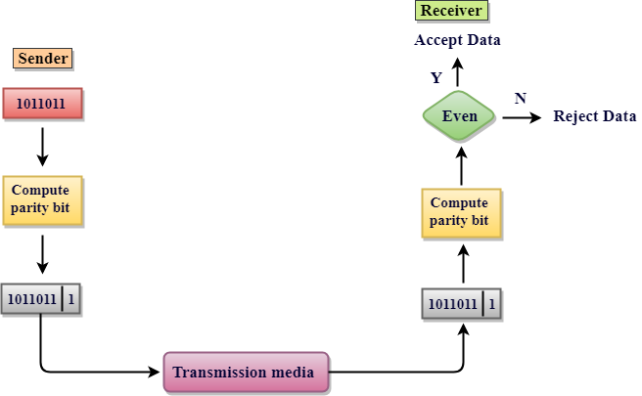

Slide 80
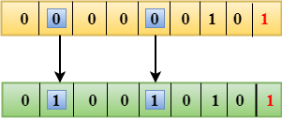
Drawbacks Of Single Parity Checking
It can only detect single-bit errors which are very rare.
If two bits are interchanged, then it cannot detect the errors.

Slide 81
2. Two-dimensional Parity check
Parity check bits are computed row, which is equivalent to the single-parity check.for each
In Two-Dimensional Parity check, a block of bits is divided into rows, and the redundant row of bits is added to the whole block.
At the receiving end, the parity bits are compared with the parity bits computed from the received data.
Drawbacks Of 2D Parity Check
If two bits in one data unit are corrupted and two bits exactly the same position in another data unit are also corrupted, then 2D Parity checker will not be able to detect the error.
This technique cannot be used to detect the 4-bit errors or more in some cases.

Slide 82
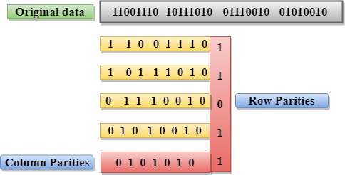

Slide 83
3. Checksum
In checksum error detection scheme, the data is divided into k segments each of m bits.
• In the sender’s end the segments are added using 1’s complement arithmetic to get the sum. The sum is complemented to get the checksum.
• The checksum segment is sent along with the data segments.
• At the receiver’s end, all received segments are added using 1’s complement arithmetic to get the sum. The sum is complemented.
• If the result is zero, the received data is accepted; otherwise discarded.

Slide 84
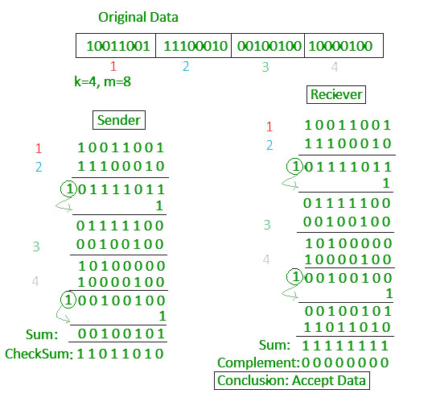

Slide 85
4. Cyclic redundancy check (CRC)
• Unlike checksum scheme, which is based on addition, CRC is based on binary division.
• In CRC, a sequence of redundant bits, called cyclic redundancy check bits, are appended to the end of data unit so that the resulting data unit becomes exactly divisible by a second, predetermined binary number.
• At the destination, the incoming data unit is divided by the same number. If at this step there is no remainder, the data unit is assumed to be correct and is therefore accepted.
• A remainder indicates that the data unit has been damaged in transit and therefore must be rejected.

Slide 86
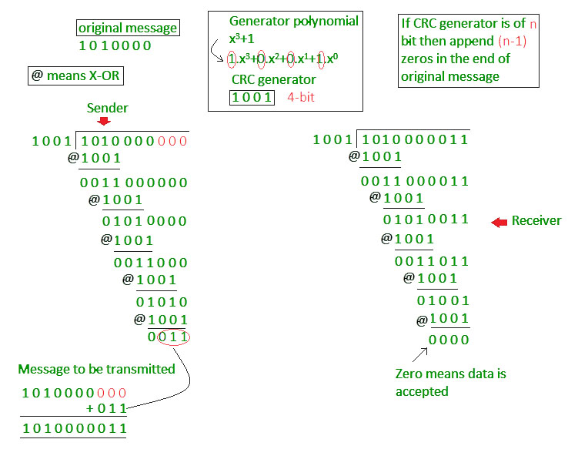

Slide 87
Error Control :
Error Control is a process of detecting and retransmitting the data which has been lost or corrupted during the transmission of data.
Error detection and correction occur at both the transport layer and the data link layer.
Types of error :
1. Single bit Error:
When there is a change in only one bit of the sender's data then it is called a single bit error.
Example: If the sender sends 101(5) to the receiver but the receiver receives 100(4) then it is a single bit error.
101(sent bits) → 100(received bits)

Slide 88
2. Burst Error:
When there is a change in two or more bits of the sender’s data then it is called a burst error.
Example: If the sender sends 1011(11) to the sender but the receiver receives 1000(8) then it is a burst error.
1011(sent bits) → 1000(received bits)

Slide 89
HDLC And Other Data Link Protocols :
It provides reliable delivery of data frames over a network or communication link. HDLC provides various operations such as framing, data transparency, error detection, and correction, and even flow control.
Primary stations simply transmit commands that contain address of secondary stations. The secondary station then simply transmits responses that contain its own address.

Slide 90
Multiplexing:
It is used in cases where the signals of lower bandwidth and the transmitting media is having higher bandwidth.
In this case, the possibility of sending a number of signals is more.
In this, the signals are combined into one and are sent over a link that has greater bandwidth of media than the communicating nodes.

Slide 91
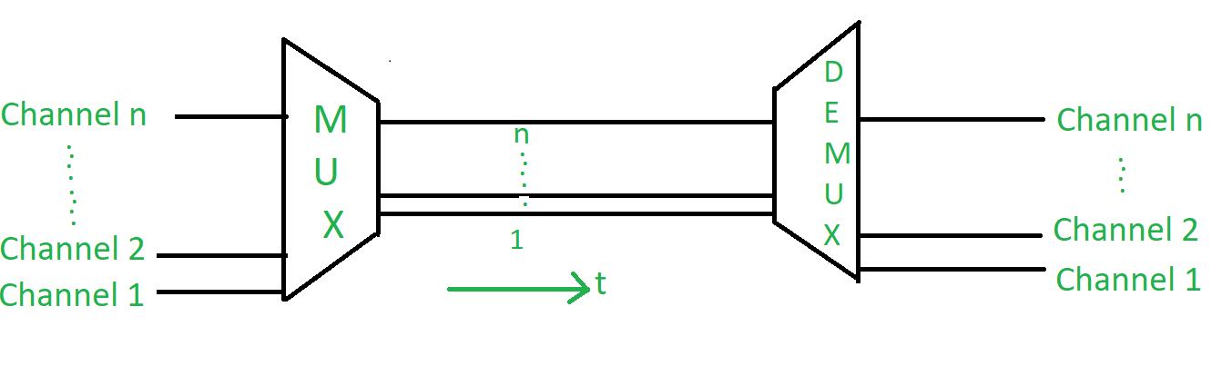
Frequency Division Multiplexing (FDM):
In this, a number of signals are transmitted at the same time, and each source transfers its signals in the allotted frequency range. There is a suitable frequency gap between the 2 adjacent signals to avoid over-lapping. Since the signals are transmitted in the allotted frequencies so this decreases the probability of collision.

Slide 92
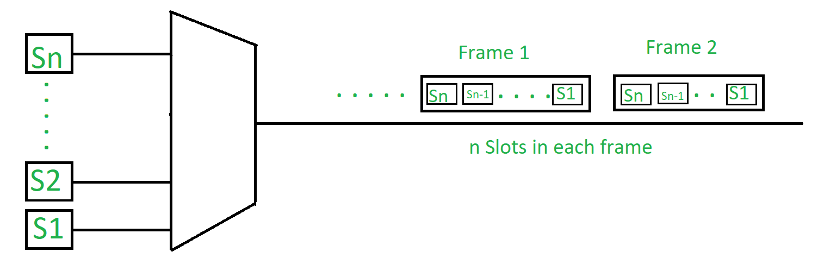
2. Time Division Multiplexing (TDM):
This happens when the data transmission rate of media is greater than that of the source, and each signal is allotted a definite amount of time. These slots are so small that all transmissions appear to be parallel. In frequency division multiplexing all the signals operate at the same time with different frequencies, but in time-division multiplexing, all the signals operate with the same frequency at different times.

Slide 93
Synchronous TDM :
In synchronous TDM, every device which is present in this has given the same time slot to transmit data. It does not consider whether the device contains data or not.
The devices place their data on the link when their time slots arrive, if somehow any device does not contain data its time-slot remains empty. There are various kinds of time slots that are organized into frames and each frame consist of one or more time slots dedicated to each sending device.
2. Asynchronous TDM :
Other name of asynchronous TDM is statistical division multiplexing. It is called so because time-slots are not fixed i.e. slots are flexible.

